Slide 1
Operators and Conditional Statements
DAY - 3

Slide 2
Operators
Operators are used to perform operations on variables and values.
Arithmetic Operators
Assignment Operators
Comparison/Relational Operators
Logical Operators
Identity Operators
Membership Operators
Bitwise Operators

Slide 3
Arithmetic Operators
They consist of:
Operator | Name | Example
+ | Addition | 5 + 2 = 7
- | Subtraction | 5 – 2 = 3
* | Multiplication | 5 * 2 = 10
/ | Division | 5 / 2 = 2.5
% | Modulus | 5 % 2 = 1
** | Exponential | 5 ** 2 = 25
// | Floor Division | 5 // 2 = 2

Slide 4
Assignment Operators
Operator | Example | Representation
= | x = 5 | x = 5
+= | x += 5 | x = x + 5
-= | x -= 5 | x = x – 5
*= | x *= 5 | x = x * 5
/= | x /= 5 | x = x / 5
%= | x %= 5 | x = x % 5
**= | x **= 5 | x = x ** 5
//= | x //= 5 | x = x // 5

Slide 5
Comparison Operators
Operator | Name | Example
== | Equal to | x == y
!= | Not equal to | x != y
> | Greater than | x > y
< | Less than | x < y
>= | Greater than equal to | x >= y
<= | Less than equal to | x <= y

Slide 6
Logical Operators
Operator | Description | Example
and | Returns True if both statements are true | x < 5 and x < 10 x < 100 and x > 200
Or | Returns True if one of the statements is true | x < 5 or x < 4
not | Reverse the result, returns False if the result is true | not(x < 5 and x < 10)
Logical operators are used to combine conditional statements

Slide 7
Identity Operators
Operator | Name | Example
Is | Returns True if both variables are the same object | x is y
Is not | Returns True if both variables are not the same object | x is not y
Identity operators are used to compare the objects, not if they are equal,
but if they are actually the same object, with the same memory location

Slide 8
Membership Operators
Operator | Description | Example
In | Returns True if a sequence with the specified value is present in the object | X in y
Not in | Returns True if a sequence with the specified value is not present in the object | X not in y

Slide 9
Bitwise Operators
Operator | Name
& | AND
| | OR
^ | XOR
~ | NOT
<< | Left Shift
>> | Right Shift

Slide 10
Task - 1
Given two numbers stored in variables a and b respectively, write a code which interchanges the values in them without using any new variables.
Example:
Input: a = 5, b = 7
Output: a = 7, b = 5

Slide 11
Conditional Statements
There are situations in programming where a specific task is to be performed if a specific condition is satisfied. In such cases, conditional statements can be used.
The following are the conditional statements provided by Python:
If statements
If – else statements
Nested if
If – elif statements
They use Boolean as parameter.

Slide 12

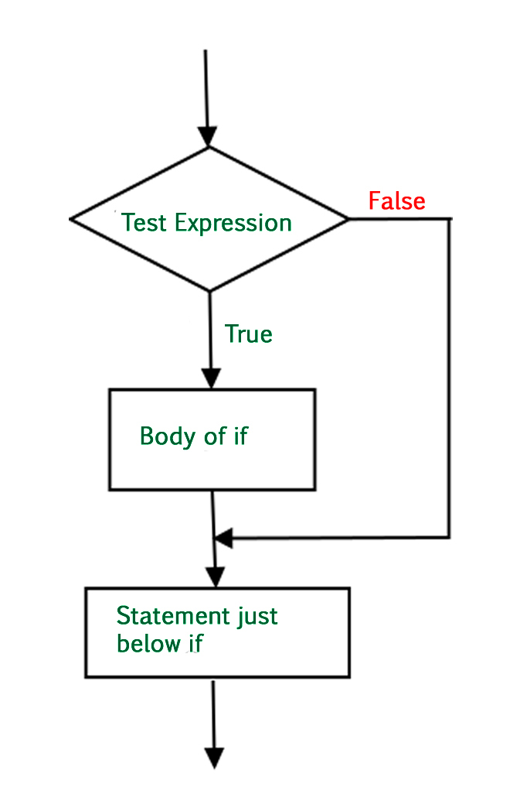
If Statement
if 10 > 5:
print("10 greater than 5")
print("Program ended")
Here, Indentation(White space) is used to delimit the block of code.

Slide 13
Task - 2
Write a code to check Voter Eligibility which gives output as “You Can Vote!!” if 18 and above.

Slide 14
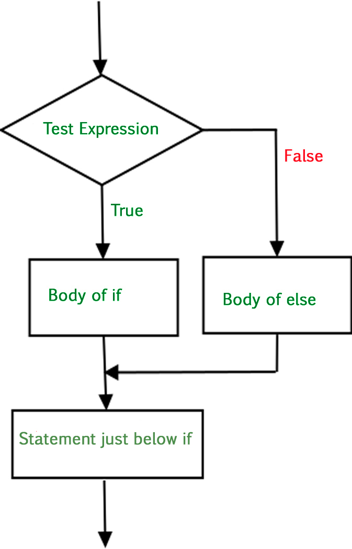
If – else Statement
Syntax
if (condition):
# Executes this block if
# condition is true
else:
# Executes this block if
# condition is false

Slide 15
Task - 3
Write a code, which:
Takes two numbers from user and gives Maximum and Minimum number as output.
Takes input from user and converts it into Celsius or Fahrenheit as required.
(°F = (°C × 9/5) + 32
It's just as easy to convert Fahrenheit to Celcius;
°C = (°F − 32) x 5/9)

Slide 16
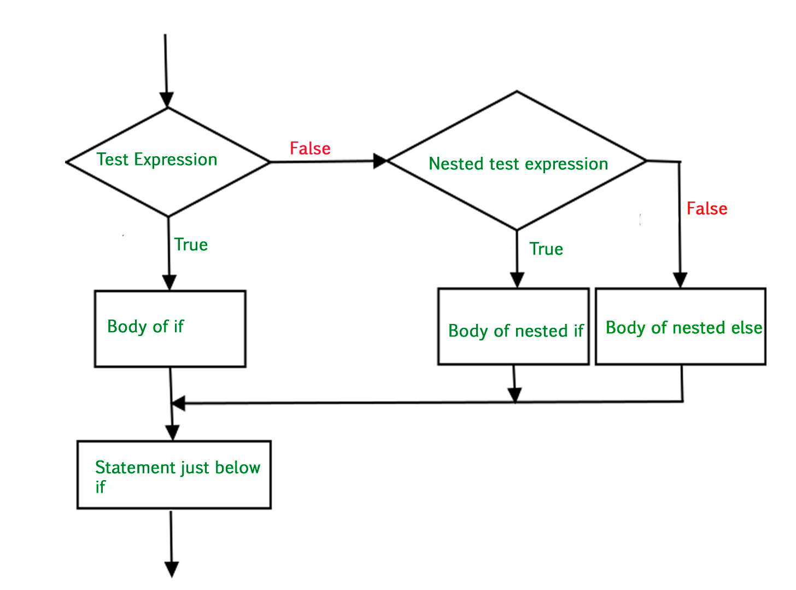
Nested If-else statements
Syntax:
if (condition1):
# Executes when condition1 is true
if (condition2):
# Executes when condition2 is true
# if Block is end here
# if Block is end here

Slide 17
Task - 4
Write a code which tells if the entered year is Leap Year or not.
A year is a leap year if the following conditions are satisfied:
The year is multiple of 400 and
The year is multiple of 4 and not multiple of 100.

Slide 18
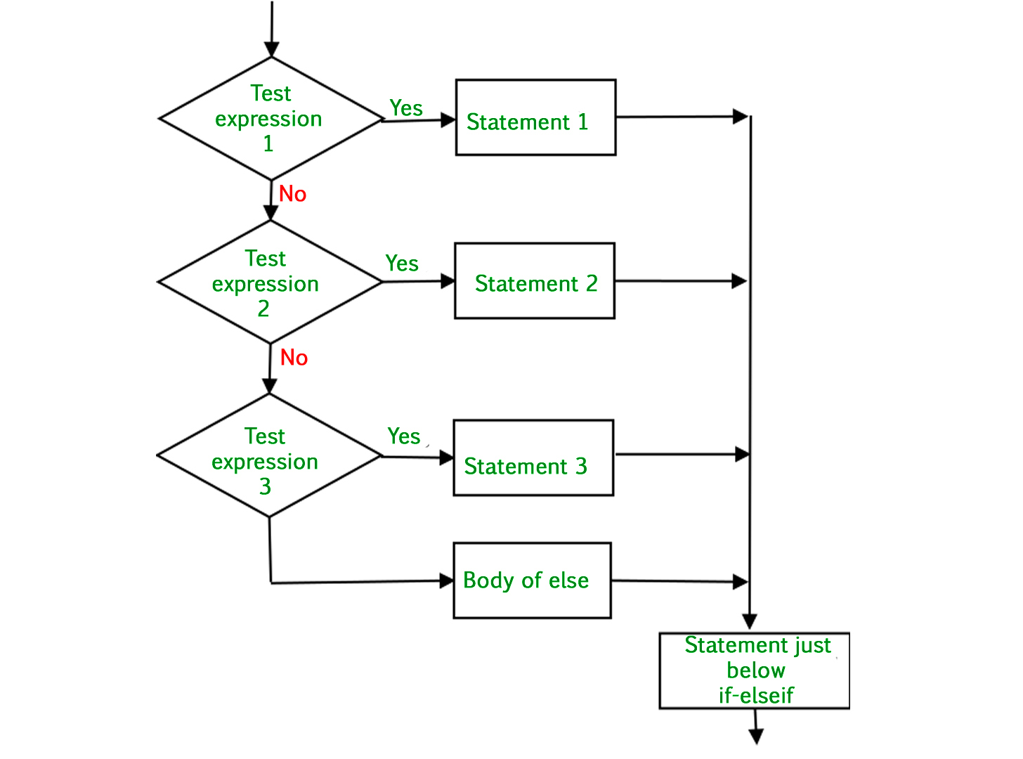
If – elif Statement
Syntax:
if (condition):
statement
elif (condition):
statement
.
.
else:
statement

Slide 19
Short-Hand and Ternary Operators
Inside if block if there is only single line of code then you can write it in one line and similarly for elif and else.
Syntax (Short-Hand):
if(condition): #code
elif (condition): #code
else: #code
Syntax (Ternary Operators):
#code if (condition) else #code

Slide 20
Task - 5
Write a python program that can tell you if your sugar is normal or not. Normal fasting level sugar range is 80 to 100.
1. Ask user to enter his fasting sugar level
2. If it is between 80 to 100 range then print that sugar is low
3. If it is above 100 then print that it is high otherwise print that it is normal

Slide 21
Homework
Create a basic calculator which takes input as two numbers and an operator (+, -, *, /) and gives the result as output.
Takes two numbers from user and gives the number whose digits have the Maximum product as output.

Slide 22
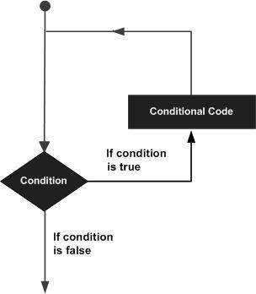
Loops
In general, statements are executed sequentially: The first statement in a function is executed first, followed by the second, and so on. There may be a situation when you need to execute a block of code several number of times.
Programming languages provide various control structures that allow for more complicated execution paths.
A loop statement allows us to execute a statement or group of statements multiple times.

Slide 23
While Loop
In while loop a certain block of code is executed until the given condition is True.
Syntax:
while expression:
statement(s)
Example:
count = 0
while (count < 3):
count = count + 1
print(“This is While Loop")

Slide 24
For Loop
For loops are used for sequential traversal. For example: traversing a list or string or array etc.
Syntax:
for iterator_var in sequence:
statements(s)
Example:
n = 4
for i in range(0, n):
print(i)

Slide 25
Loop Control Statements
Break: Terminates the loop statement and transfers execution to the statement immediately following the loop.
Continue: Causes the loop to skip the remainder of its body and immediately retest its condition prior to reiterating.
Pass: The pass statement in Python is used when a statement is required syntactically but you do not want any command or code to execute.

Slide 26
Task - 6
Write a code to display multiplication table of a number taken from user.
Write a code to display addition of first n Natural numbers.
Write a code for Fibonacci Series.
Write a code to list Prime numbers up to 20.

Slide 27
Thank You

